Slide 1




EazyTrip
Smart Paths, Easy Rides
By : ODD CODER

Slide 2



Overview
Introduction
03
Users (Admin)
04
Users (Customer)
05
Users (Rider)
08
Features
11
Conclusion
12

Slide 3

Introduction
Introducing EAZYTRIP, a sophisticated app designed to revolutionize ride and delivery services. EAZYTRIP creates a seamless interaction between admins, users, and riders. Admins efficiently manage and optimize a custom-made map, ensuring precise routing. Users can effortlessly request rides or deliveries, benefiting from accurate cost and shortest distance calculations, enabled by our optimized code. Riders promptly fulfill these requests, enhancing overall convenience and reducing travel times.
03

Slide 4
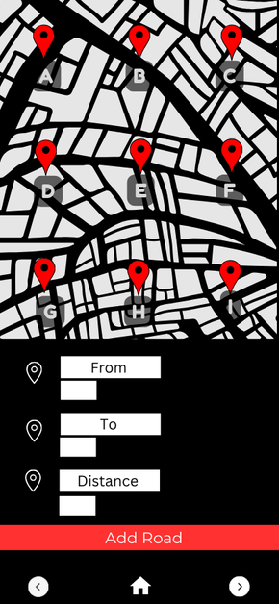

Users of EazyTrip
Admin
Admins manage the backbone of EAZYTRIP by creating and optimizing a custom map. They add and connect various locations, ensuring accurate routing for users and riders. This efficient map management enables precise shortest distance calculations and cost estimates, enhancing the overall functionality and reliability of the app.
04

Slide 5
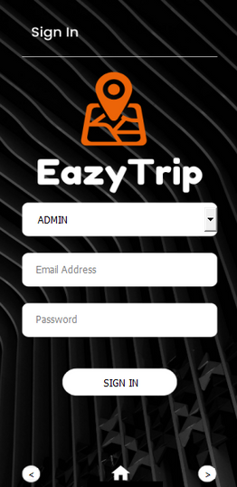
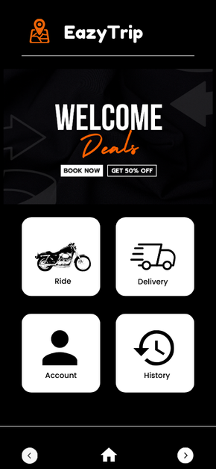
Customers Panel
Account Management:
Sign Up and Sign In:
Customers can create an account and log in securely.
Profile and History
Customers can view and update their profile information and access their ride and delivery request history.
05

Slide 6
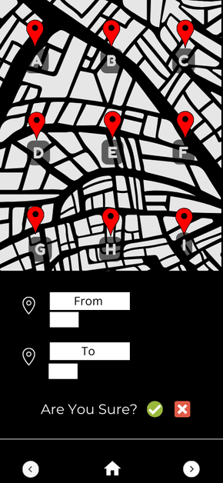
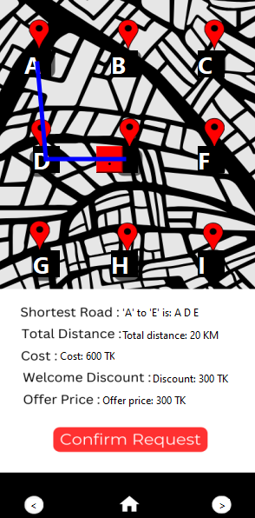
Customers Panel
Service Requests
Ride Order:
Customers can request rides from one location to another.
Parcel Delivery:
Customers can request the delivery of parcels from one location to another.
06

Slide 7



Customers Panel
Interaction
View Order Status
Provide Feedback
Customers can track the status of their ride and delivery requests.
Customers can provide feedback on their experience with the service.
07

Slide 8
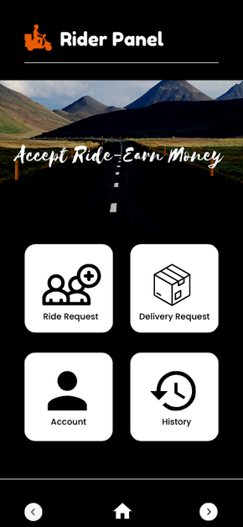
Rider Panel
Account Management:
Sign Up and Sign In:
Riders can create an account and log in securely.
Profile and History
Riders can Access history of accepted requests.
08

Slide 9
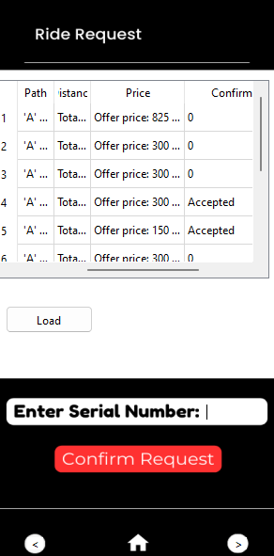
Rider Panel
Service Fulfillment
Riders can see pending ride and delivery requests from Customers.
Riders can accept requests they wish to fulfill.
09

Slide 10
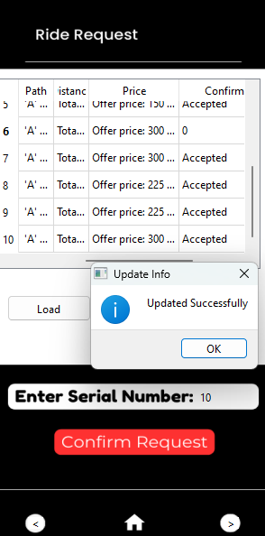
Rider Panel
Interaction
Update Order Status:
Riders update the status of accepted requests, providing real-time updates to Customers.
View Feedback
Riders can view feedback provided by Customers on completed requests.
10

Slide 11




Features
Custom Map
Shortest Road
Cost Saving
EAZYTRIP features a customizable map for precise route management. Administrators can define accurate connections between locations, ensuring efficient routing for ride and delivery requests, enhancing reliability and user satisfaction.
EAZYTRIP employs advanced algorithms to calculate the shortest routes between locations in real-time. This feature ensures efficient travel and delivery times, optimizing user experience and operational efficiency.
EAZYTRIP saves costs for customers by calculating the shortest distance between locations. This optimization reduces travel expenses and enhances affordability while maintaining efficient service delivery.
11

Slide 12







EazyTrip
Our
Team
Mohammed Hasan
Leader
THANK YOU!
Ride Smart, Safe Money
Shanjid Mahammad
Prasenjit Chowdhury
12

